Slide 1
Atrial Fibrillation & Stroke Prevention
Risk Stratification, Prevention Strategies, Emerging Evidence, & Knowledge Gaps
(Neurologist Perspective)
Rizwan Kalani

Slide 2
Objectives
1
Evaluate stroke risk stratification tools including performance metrics & limitations
2
Understand stroke prevention strategies: anticoagulation, timing after stroke, alternatives
3
Introduce emerging approaches and select knowledge gaps in AF-related stroke prevention

Slide 3
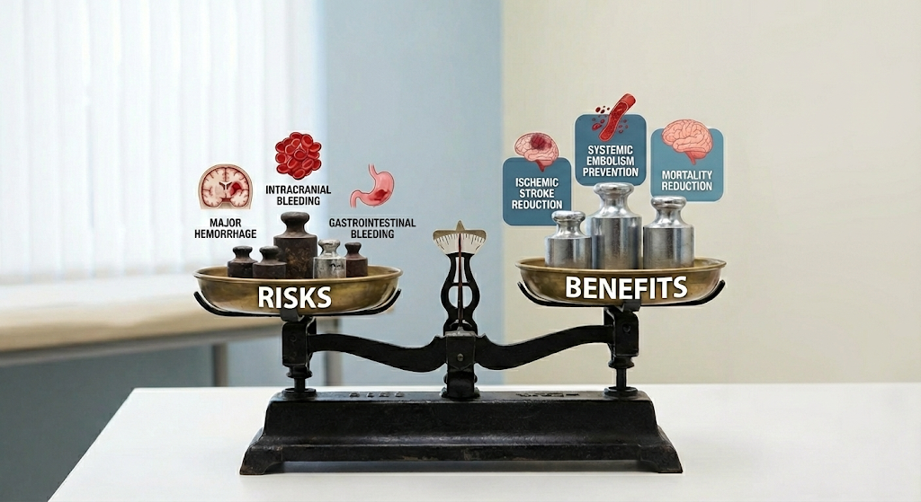
Clinical Risk Stratification
AF & Stroke Risk
AF ↑ stroke risk ~5X
Absolute risk varies widely
Anticoagulation ↓ stroke risk ~60-70%, but ↑ bleeding
Decision Framework & Treatment Threshold
Net Clinical Benefit = stroke risk reduction – major hemorrhage risk increase
Circulation. 2023 Dec 5;148(23):e1-e125.
Image generated with Google Gemini

Slide 4
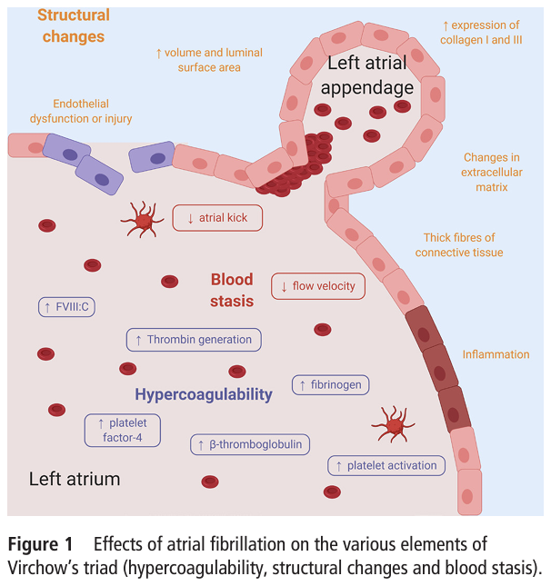
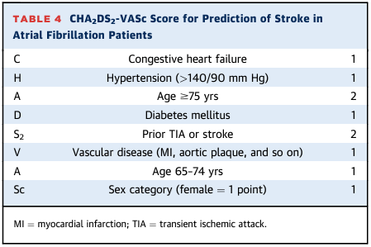
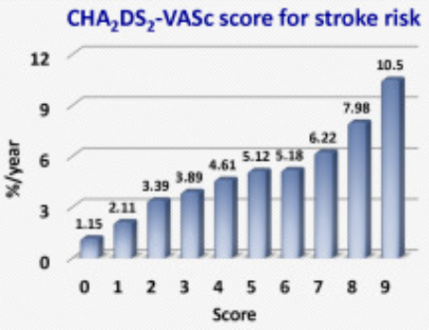
CHA₂DS₂-VASc Risk Score
J Am Coll Cardiol. 2020 Apr 14;75(14):1689-1713.
Eur Heart J. 2012 Jun;33(12):1500-1510. Circulation. 2023 Dec 5;148(23):e1-e125.
Heart. 2020 Oct;106(19):1463-1468.

Slide 5
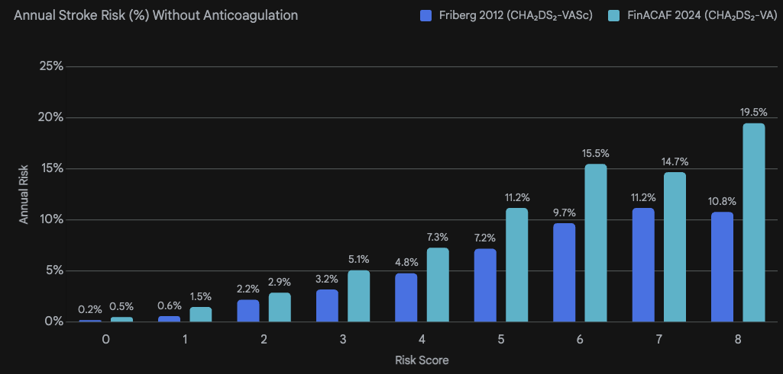
CHA₂DS₂-VASc: Performance Characteristics
Discrimination & Calibration
C-statistic: ~0.65 (modest)
Variable across populations
Overestimates in certain subgroups
Limitations
Binary variables (loss of granularity)
No AF burden/type or renal function
Why is it clinically useful?
High negative predictive value (identifies true “low risk” from “not low risk”) → is risk low enough to avoid anticoagulation?
Simplicity → clinical factors, reproducible, scalable
2024 ESC: CHA₂DS₂-VA
Female sex is modifier (not independent risk factor)
Circulation. 2012 May 15;125(19):2298-307.
Lancet Reg Health Eur. 2024 Jun 10;43:100967.

Slide 6
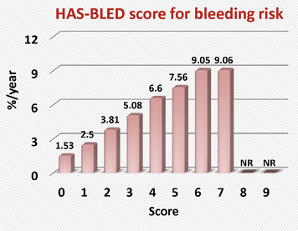
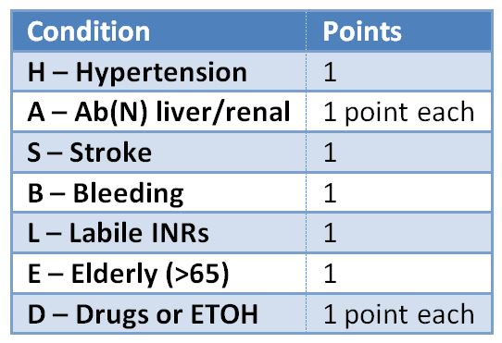
Bleeding Risk
HAS-BLED Score
Score ≥3 = High hemorrhage risk
C-index ~0.6
High hemorrhage risk ≠ "Don't anticoagulate"
• Identify & address modifiable risk factors
• Guide monitoring intensity
Often hemorrhage risk < stroke risk
* Developed in warfarin treatment era
Am J Med. 2020 Oct;133(10):1195-1202.e2.
Lancet Reg Health Eur. 2024 Feb 1;37:100797.
Chest. 2010 Nov;138(5):1093-1100.
Eur Heart J. 2012 Jun;33(12):1500-1510.

Slide 7
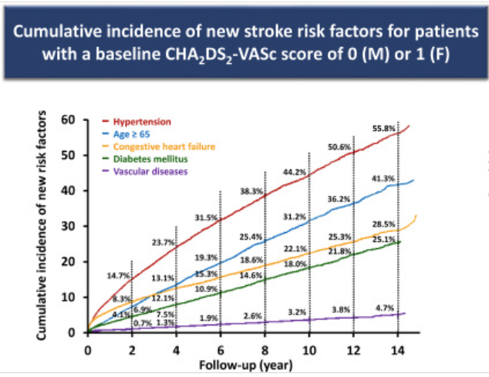
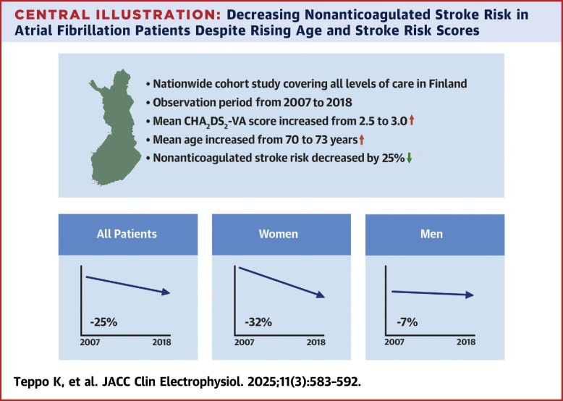
Risk is Dynamic
Multimorbidity → Δ net clinical benefit of treatment
Age
Accumulation risk factors for stroke & hemorrhage
J Am Coll Cardiol. 2018;71(2):122-132.
Thromb Haemost. 2018 Jul;118(7):1296-1304.
Eur Heart J. 2024 May 27;45(20):1819-1827.

Slide 8
💬 Discussion Question
FinACAF 2024 cohort shows higher stroke rates at each score compared to Friberg 2012 - what factors contribute to temporal shift?
Competing risks from AC uptake
Survivor bias
AF detection changes
Comorbidity burden shift
Methodological differences
Lancet Reg Health Eur. 2024 Jun 10;43:100967.

Slide 9
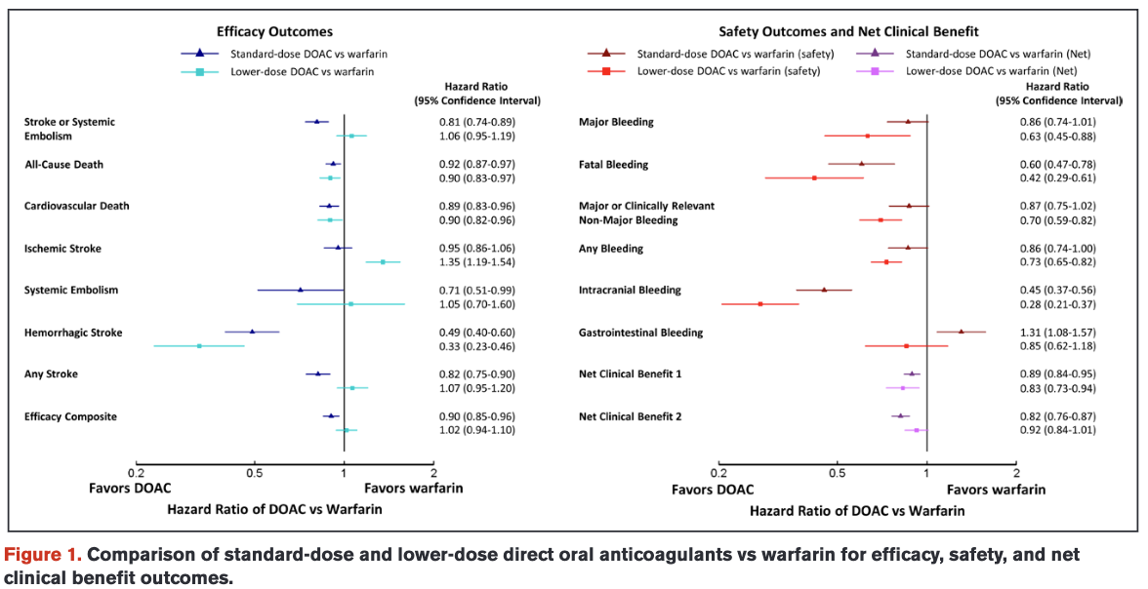
Anticoagulation
DOACs vs. Warfarin
DOACs > warfarin
Among DOACs → no direct comparative trials
Apixaban preferred (↓ hemorrhage risk)
Warfarin → mechanical valves, mitral stenosis
* Aspirin alone NOT recommended
Circulation. 2022 Jan 25;145(4):242-255.
Eur J Epidemiol. 2021 Aug;36(8):793-812.

Slide 10
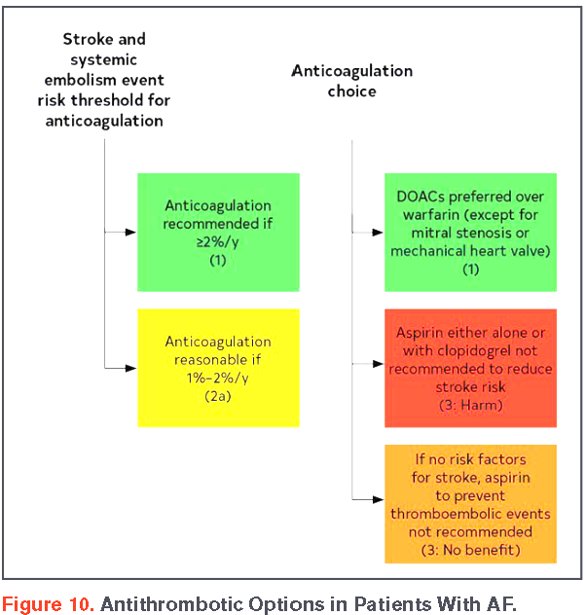
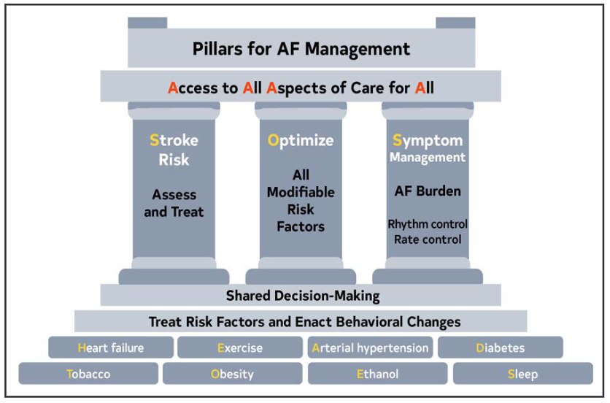
Comprehensive Atrial Fibrillation Management
J Am Coll Cardiol. 2024 Jan 2;83(1):109-279.

Slide 11
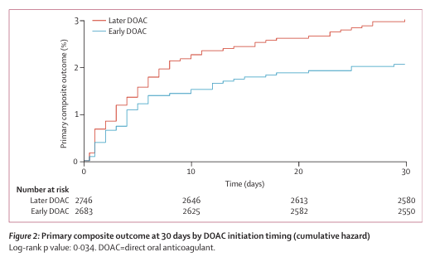
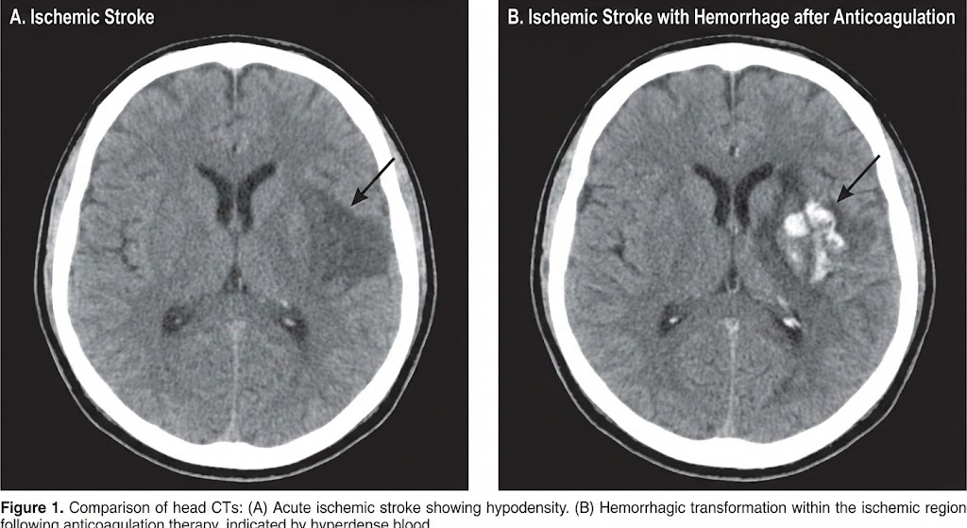
Timing After Acute Ischemic Stroke
CATALYST meta-analysis
ELAN Trial (n=2,013)
Individual participant data meta-analysis of 4 trials (TIMING, ELAN, OPTIMAS, START)
Population: acute ischemic stroke + AFib
Treatment/Comparator: DOAC initiation ≤4 days (early) or ≥5 days (late)
Outcome: (composite) recurrent ischemic stroke or symptomatic ICH in ≤ 30 days
Early DOAC initiation reduced risk
Limited generalizability to severe stroke, hemorrhagic transformation
Small-moderate infarct → ≤ 2-4 days
Large infarct → 1-2 weeks
Lancet. 2025 Jul 5;406(10498):43-51.
Lancet Neurol. 2024 Apr;23(4):404-417.

Slide 12
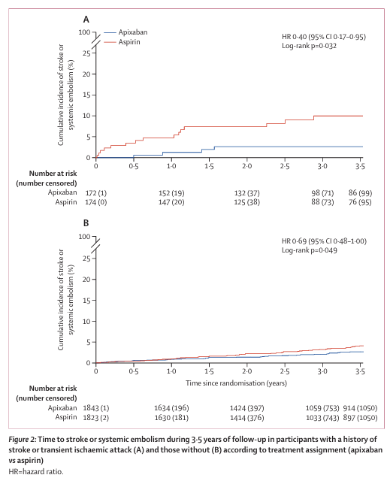
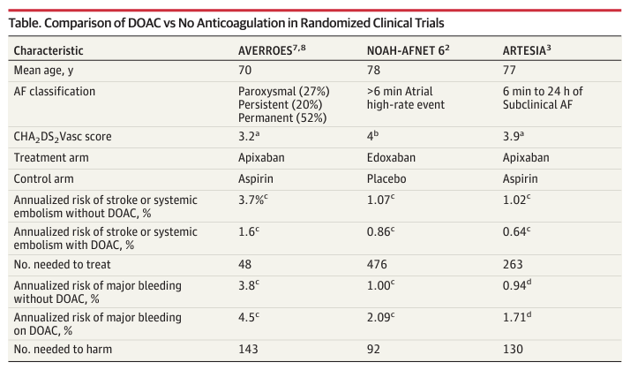
Low-Burden AF
Asymptomatic
Device-detected
6 minutes – 24 hours
Lower stroke risk than clinical AF
AC decisions require more nuanced shared decision-making
JAMA Neurol. 2024 Jun 1;81(6):573-574.
Lancet Neurol. 2025 Feb;24(2):140-151.

Slide 13
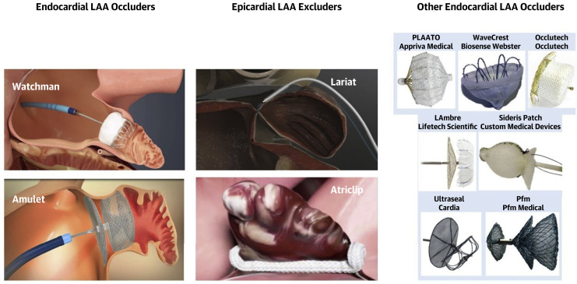
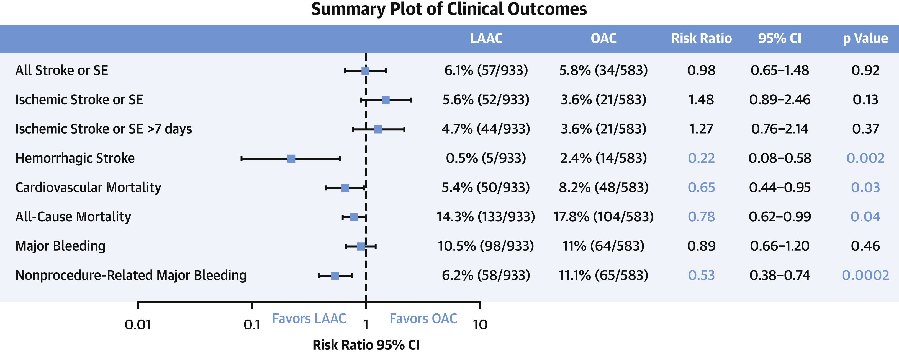
Left Atrial Appendage Occlusion (LAAO) - Percutaneous
Rationale
~80-90% of AF thrombi form in the LAA
Occlude LAA → eliminate source of most thromboembolism → Avoid long-term anticoagulation
Considered for ABSOLUTE contraindication to long-term AC → NOT first-line alternative to DOACs
Non-inferiority of LAAO to DOACs uncertain (high-risk groups)
Requires post-procedure anticoagulation (or dual AP treatment)
J Am Coll Cardiol. 2020 Apr 14;75(14):1689-1713.
J Am Heart Assoc. 2021 Nov 2;10(21):e022274
J Am Coll Cardiol. 2022 Jan 4;79(1):1-14.

Slide 14
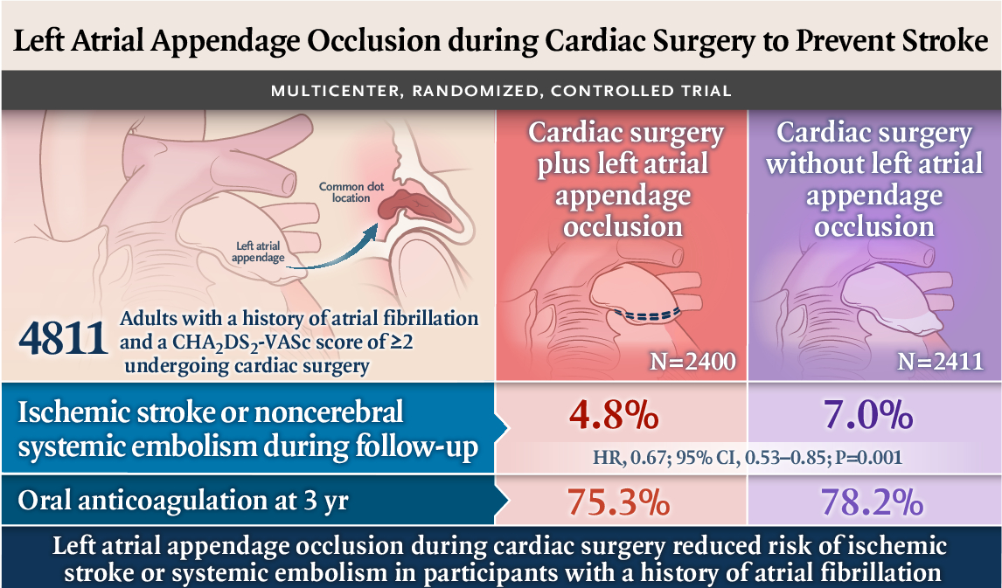
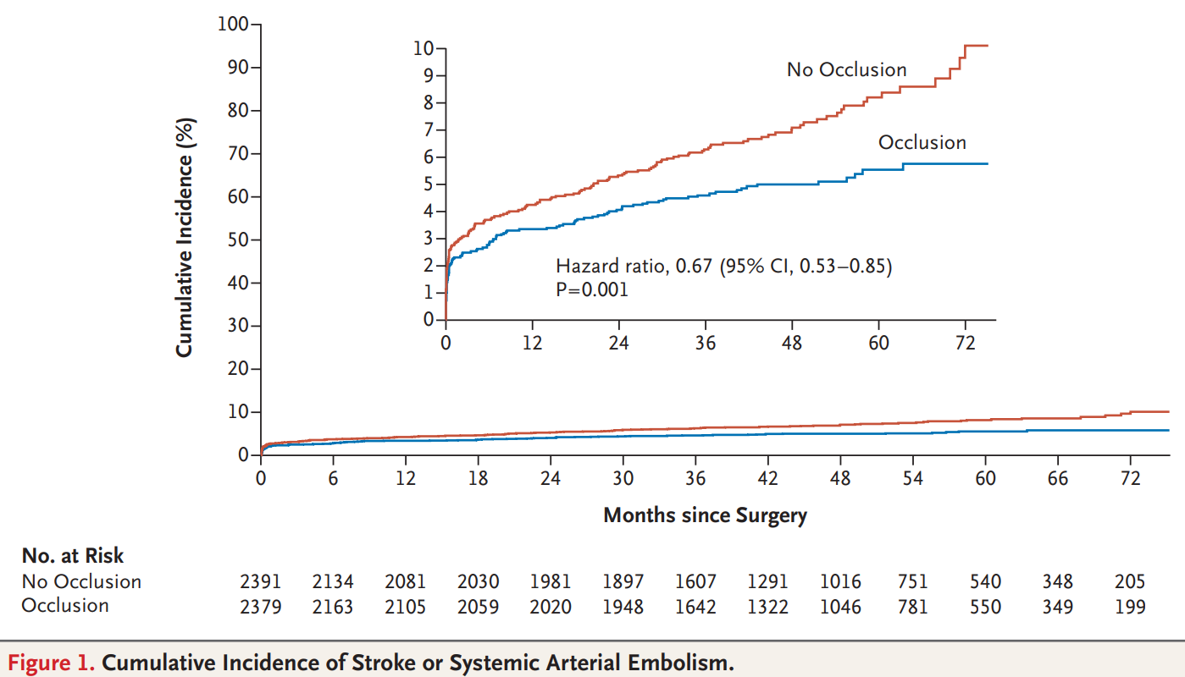
💬 Discussion Question
Left Atrial Appendage Occlusion (LAAO) - Surgical
Points to Consider:
Why was AC continued in most?
How should findings be interpreted?
Lack of clinical equipoise
Real-world uncertainty
How were 23% that stopped AC different?
→ Supports LAAO + AC may further reduce stroke risk
Mean CHADS₂VASc ~4
~77% on AC @ 3 y
N Engl J Med. 2021 Jun 3;384(22):2081-2091.

Slide 15
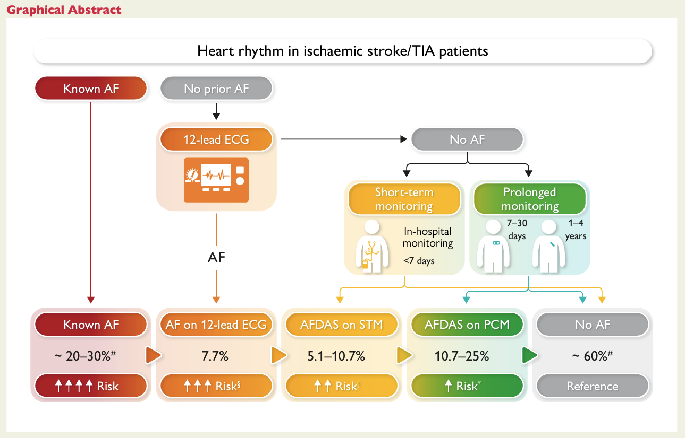
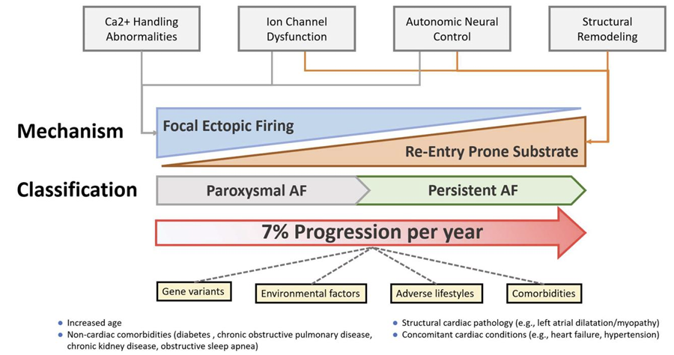
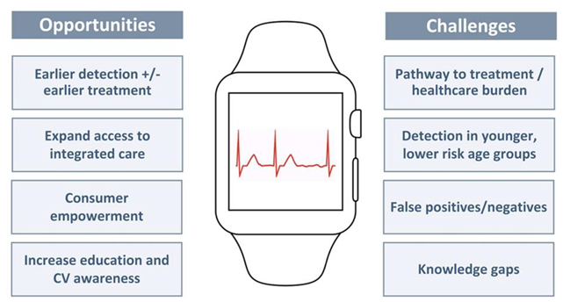
Knowledge Gap: Detection – Outcome Disconnect
Screening ↑ detection, BUT early detection ≠ ↓ stroke/mortality
Low-burden → higher burden
Treatment threshold
Eur Heart J. 2026 Jan 7;47(2):170-187.
Eur Heart J. 2024 Feb 1;45(5):396-398.

Slide 16
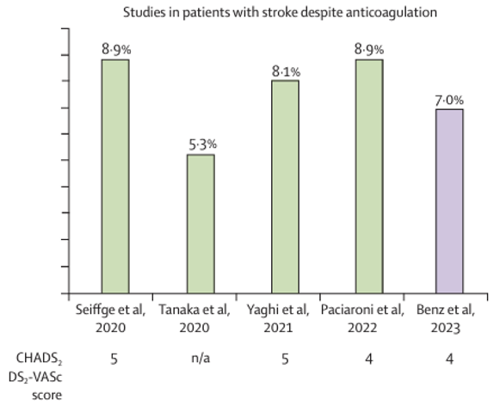
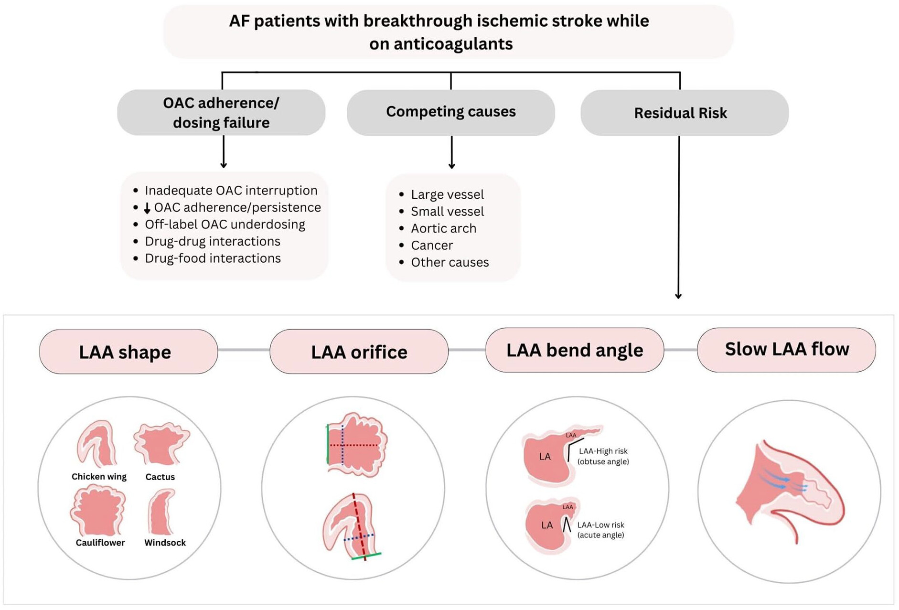
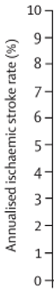
Knowledge Gap: Recurrent Stroke Despite AC
🛑 Switching DOACs or addition of aspirin ✋
LAAO + AC
Factor XI inhibitors
Lancet Neurol. 2024 Apr;23(4):404-417.
Int J Stroke. 2025 Apr;20(4):385-400.

Slide 17
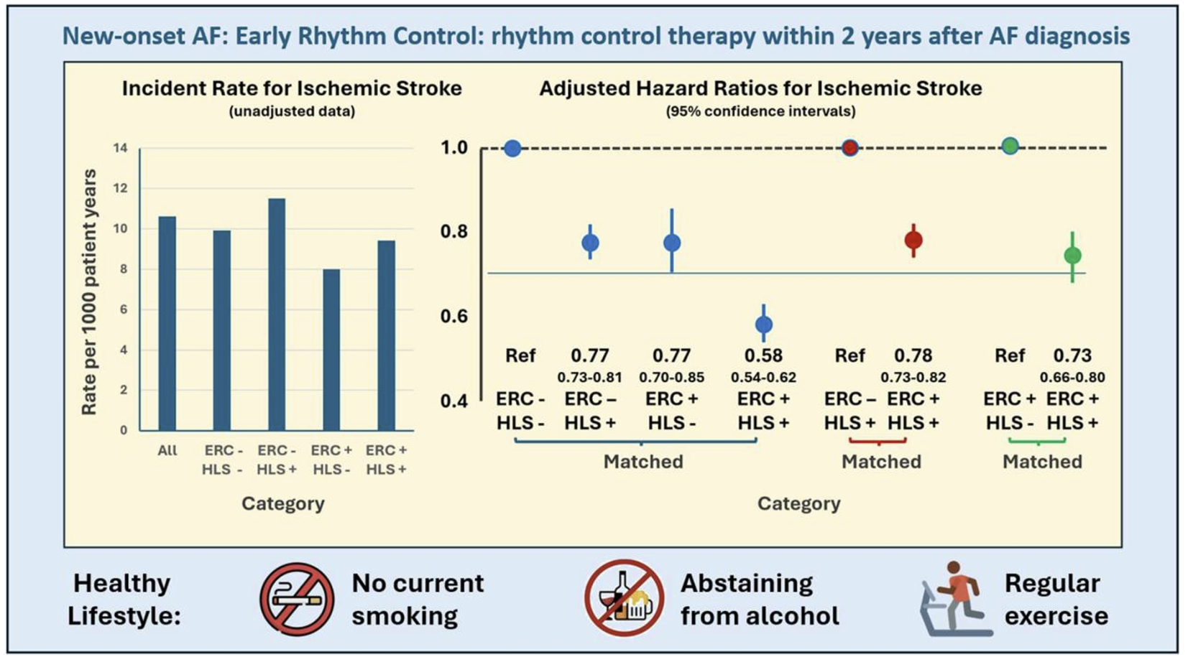
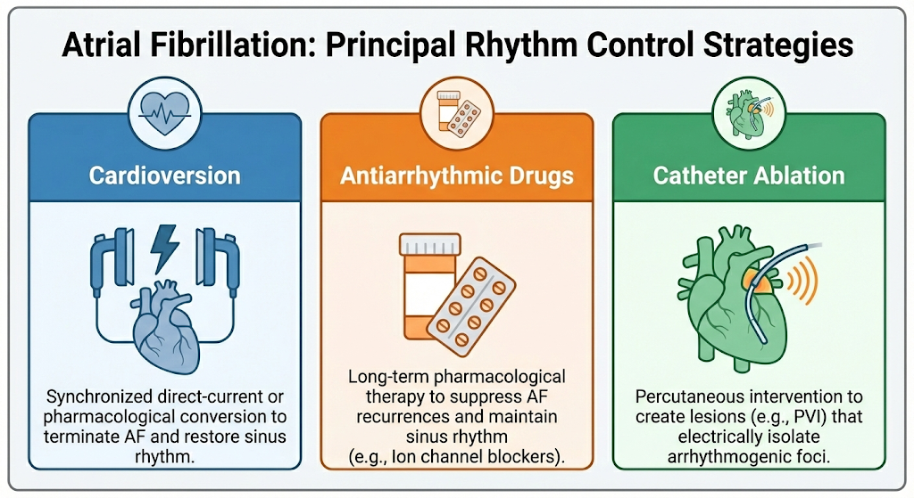
Knowledge Gap: Early Rhythm Control
↓ stroke risk (by ↓ AF burden)
Successful restoration of sinus rhythm ≠ discontinuation of AC
High risk of recurrence
Subgroup? – early onset, low-burden, low CHA₂DS₂VASC
Int J Stroke. 2025 Apr;20(4):385-400.
Eur Heart J. 2026 Jan 7;47(2):170-187.
Image generated with Google Gemini

Slide 18
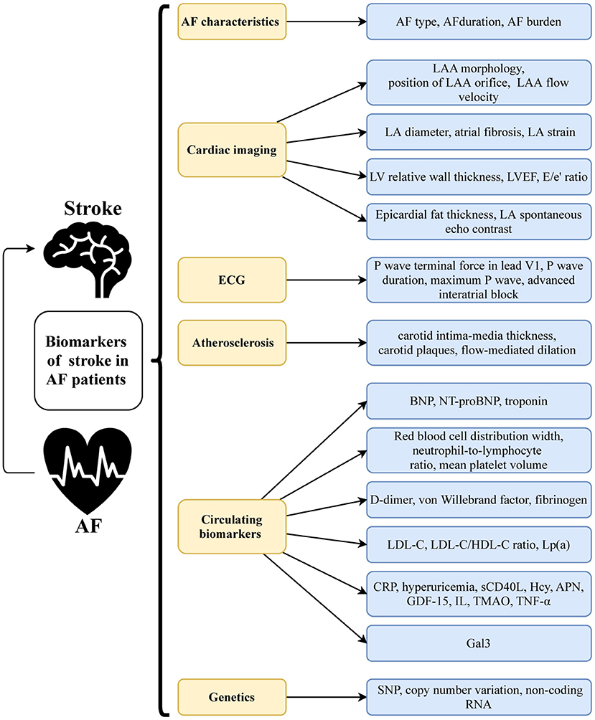
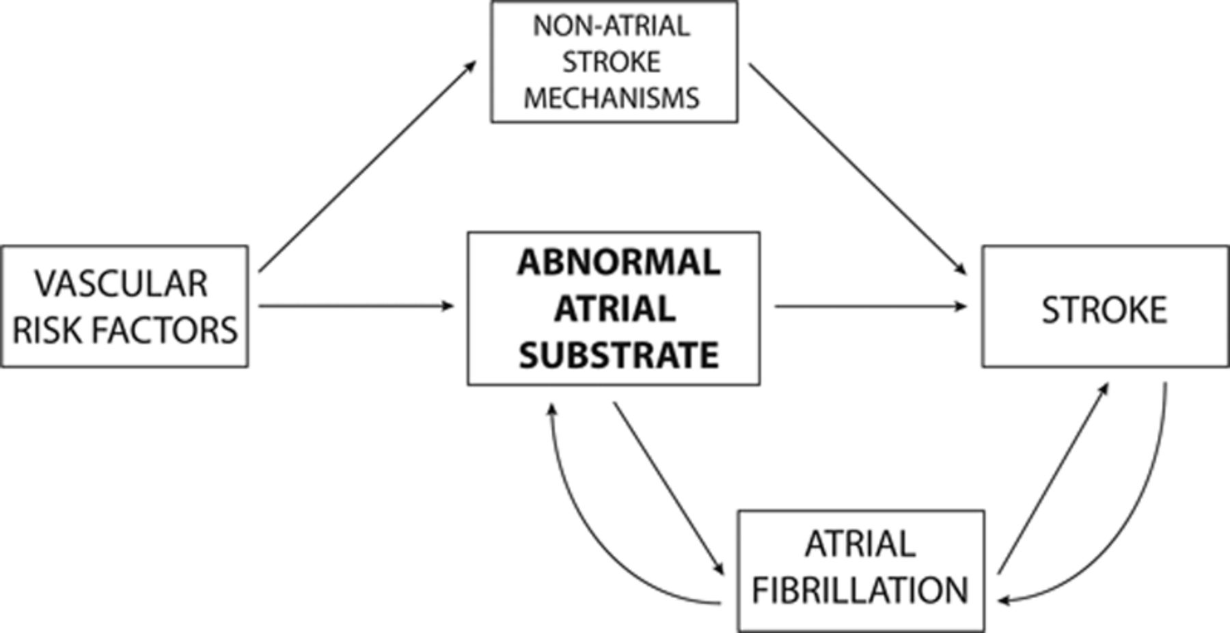
Knowledge Gap: Risk & Therapeutic Biomarkers
Cardiac Structural
Electrophysiologic (EKG markers)
Circulating (proteins, metabolites)
Stroke. 2016 Mar;47(3):895-900.
Front Cardiovasc Med. 2021 Jul 1;8:682538.

Slide 19

Questions?

